Slide 1
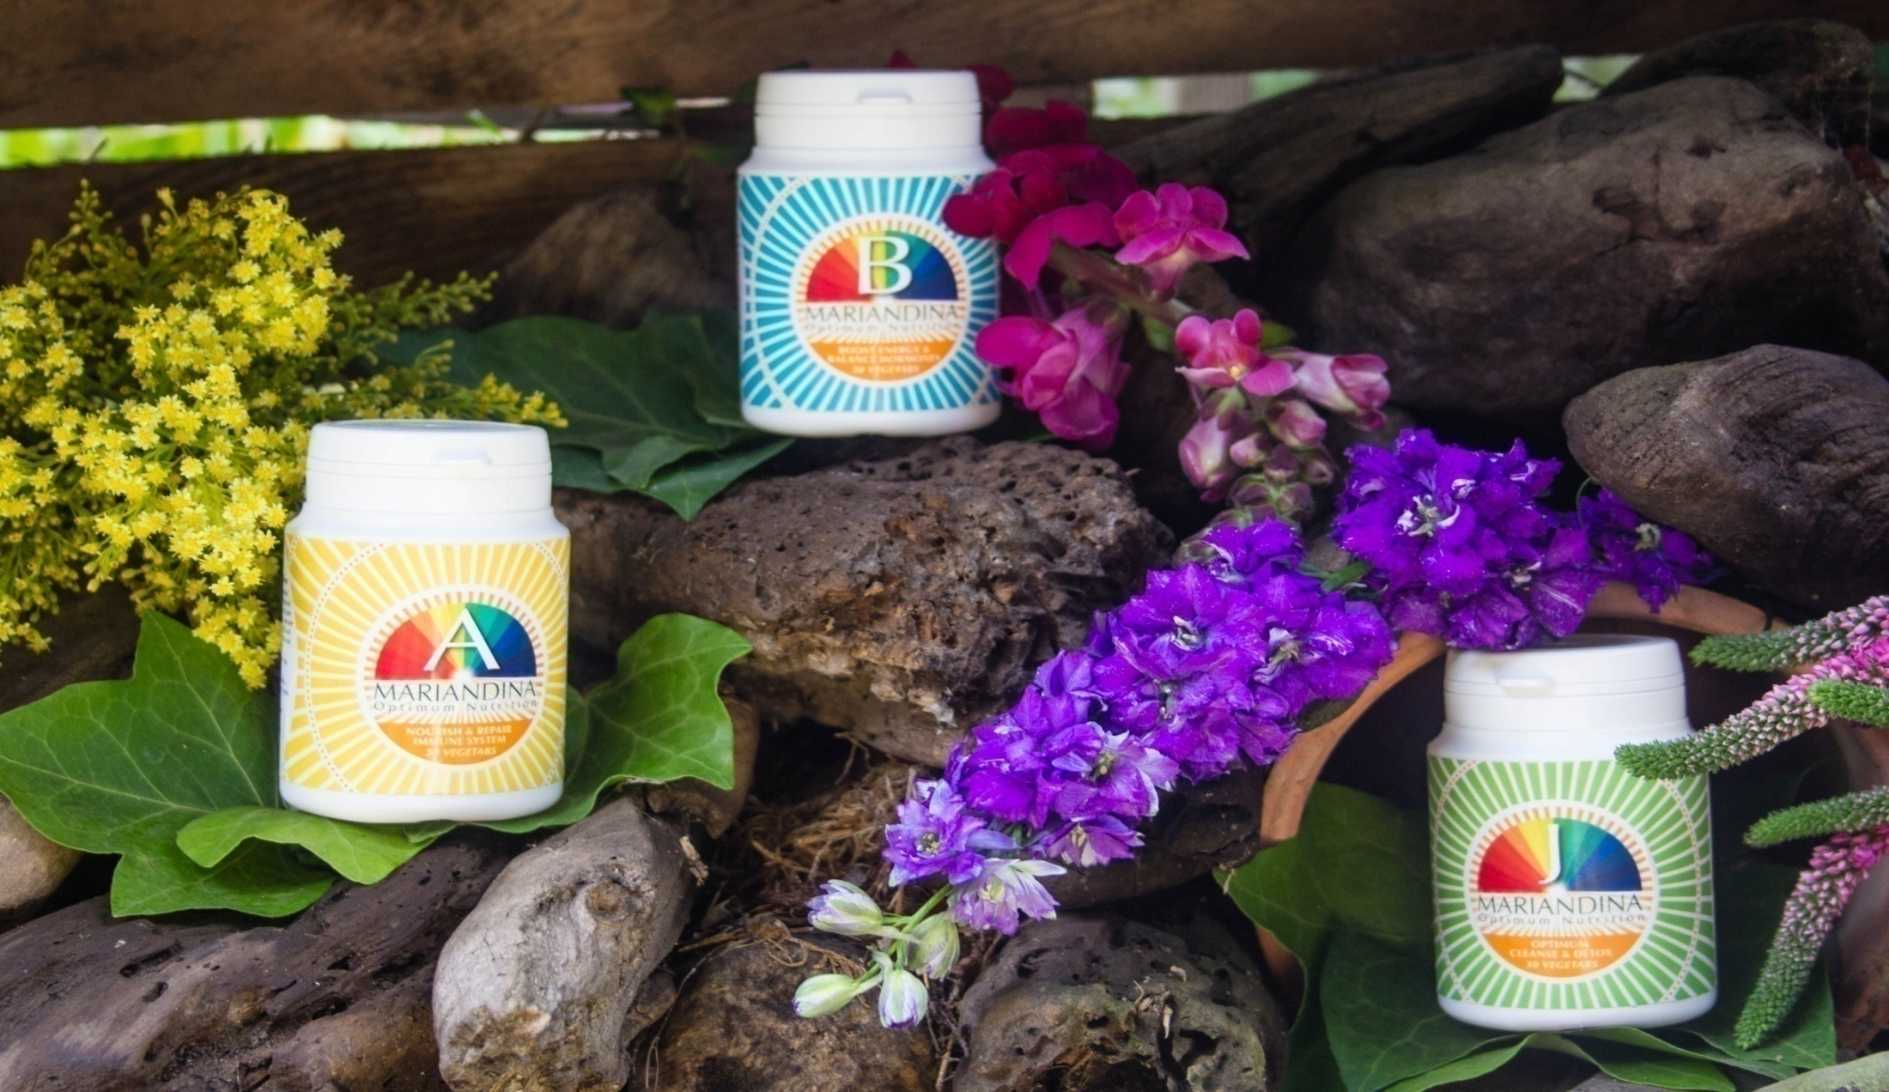
MARIANDINA HOLISTIC WELLNESS THE HEALING POWER OF SUPER ANTIOXIDANTS AND YOUR IMMUNE SYSTEM

Slide 4
MARIANDINA A is a natural food supplement
THAT BOOSTS THE IMMUNE SYSTEM AND REPAIRS BODY CELLS AND TISSUES.
MARIANDINA A INGREDIENTS
CHROMIUM
ZINC
QUECERTIN
VITAMIN C
COPPER
VITAMIN E
FOLIC ACID
VITAMIN B6
SIBERIAN GINSENG
VITAMIN B2
IODINE
VITAMIN B1
CHOLINE
VITAMIN A
LYSINE
SELENIUM
MAGNESIUM
RUTIN BIOFLAVONOIDS
MOLYBDENUM
MANGANESE

Slide 5
LLL
MARIANDINA A is a natural food supplement
THAT BOOSTS THE IMMUNE SYSTEM AND REPAIRS BODY CELLS AND TISSUES.
MARIANDINA A INGREDIENTS
SELENIUM helps protect the body from cancer.
ZINC boosts immunity, repairs wounds and protects cells.
VITAMIN C required for collagen and prevents oxidative stress.
VITAMIN E protects cell membranes, reduces risk of heart disease.
VITAMIN B6 processes Amino acids, lowers homocysteine levels
MAGNESIUM relaxes muscles, arteries, improves insulin resistance
IODINE is used make thyroid hormones and normal metabolism
COPPER assists in absorption of Iron and to produce melanin
CHROMIUM used for insulin production, aids fat loss, muscle gain
FOLIC ACID required for DNA synthesis and normal cell replication
QUECERTIN is anti-histamine and anti-inflammatory, protects LDL
VITAMIN B12 used in nerve cell activity, DNA replication, mood
VITAMIN A helps cells reproduce normally, stimulates immunity

Slide 6
MARIANDINA B is a natural food supplement that boosts the bodies ENERGY LEVELS, IMPROVES CIRCULATION, BALANCES HORMONES.
MARIANDINA B INGREDIENTS
ALFALFA
GOLDEN SEAL
BEE POLLEN
GOTU KOLA
BETA-CAROTENE
GURANA
CAYENNE
SIBERIAN GINSENG
HAWTHORN
COENZYME Q10
LICORICE
ECHINACEA
VITAMIN C
GARLIC
YELLOW DOCK
VITAMIN E
KOLA NUT
GINKGO BILOBA

Slide 7
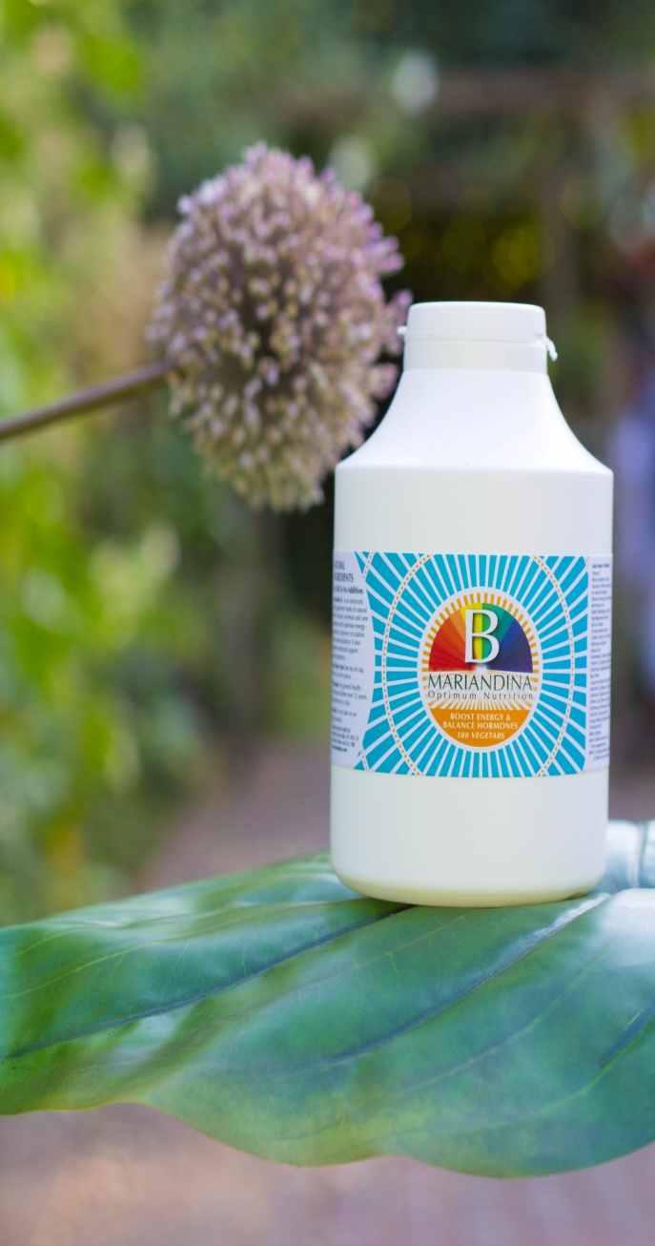
MARIANDINA B is a natural food supplement that boosts the bodies ENERGY LEVELS, IMPROVES CIRCULATION, BALANCES HORMONES.
MARIANDINA B INGREDIENTS
ALFALFA treats digestive disorders, water retention and Arthritis
BEE POLLEN has anti-inflammatory properties, relaxes muscles
BETA CAROTENE helps cells reproduce, stimulates immunity
CAYENNE treats circulation system, relieves pains of Arthritis
COENZYME Q10 aids metabolic reactions ATP, heart function
ECHINACEA supports the Immune system treats colds and flu
GARLICsupports cardiovascular system,antibacterial/viral/fungal
GINKGO BILOBAimproves memory,prevents clots,Brain function
KOLA NUT stimulates nervous system, relieves migraines
SIBERIAN GINSENG detoxifies harmful toxins, improves stamina
GOLDEN SEALheals inflammation in digestive,respiratory,urinary
GOTU KOLAboosts mental activity, wound healing, injuries, HBP
GURANA diarrhea, stimulates nervous system, metabolic rate
HAWTHORN heals the Heart, lowers high blood pressure
LICORICE anti-inflammatory, anti-viral, treats viral hepatitis
YELLOW DOCK aids digestion, treats skin conditions, treats skin
VITAMIN C required for collagen and prevents oxidative stress.
VITAMIN E protects cell membranes,reduces risk of heart disease.

Slide 8
MARIANDINA J is a natural food supplement that
CLEANSES AND DETOXIFIES THE BODY
MARIANDINA J INGREDIENTS
YARROW
GOLDEN SEAL
ASTRAGALUS
HORSETAIL
BED STRAW
COLTSFOOT
BARBERRY
ECHINACEA
OREGON GRAPE
DEVIL’S CLAW
BLACK COHOSH
DANDELION
CALAMUS ROOT
COWSLIP
GARLIC
COMFREY
CALENDULA
SIBERIAN GINSENG
CLEAVERS
CHAMOMILE

Slide 9
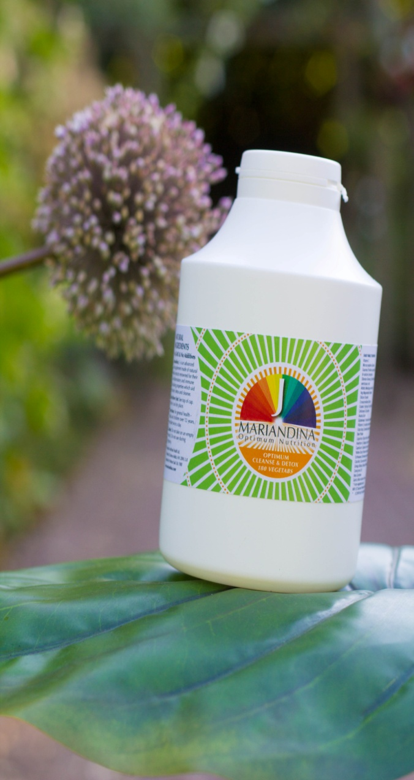
MARIANDINA J is a natural food supplement that
CLEANSES AND DETOXIFIES THE BODY
MARIANDINA J INGREDIENTS
YARROW treats wounds,fevers,colds,inflammation,hypertension
GARLICsupports cardiovascularsystem,antibacterial/viral/fungal
ASTRAGALUS stimulates immune system, lowers blood pressure
BED STRAW is a diuretic, relieves Edema,heals lymphatic system
BARBERRY treats Bronchitis, infections, Gastritis, inflammation
OREGON GRAPE treats inflammation, skin disease Psoriasis
BLACK COHOSH for menopause, aids painful periods, insomnia
CALMUS ROOTanti- parasitic,stomach problems,anti-arrhythmic
CALENDULA treats inflammation, treats skin conditions, wounds
CHAMOMILE anti-inflammatory, treats gastrointestinal tract.
CLEAVERS relieves Edema, jaundice, lymph swellings, wounds
COLTSFOOT anti-inflammatory, cough prevention and treatment
COMFREY treats inflammation,repairs bones, skin ulcers, strains
COWSLIP anti-inflammatory, treats pertussis, bronchitis,arthritis
DANDELIONtreats liver, gall bladder,kidney, joints. purifies Blood
SPIRULINA is anti cancer,anti-allergy, liver protecting, immunity
ST. JOHN’S WORT depression,kidneys and lungs, wounds, burns

Slide 10
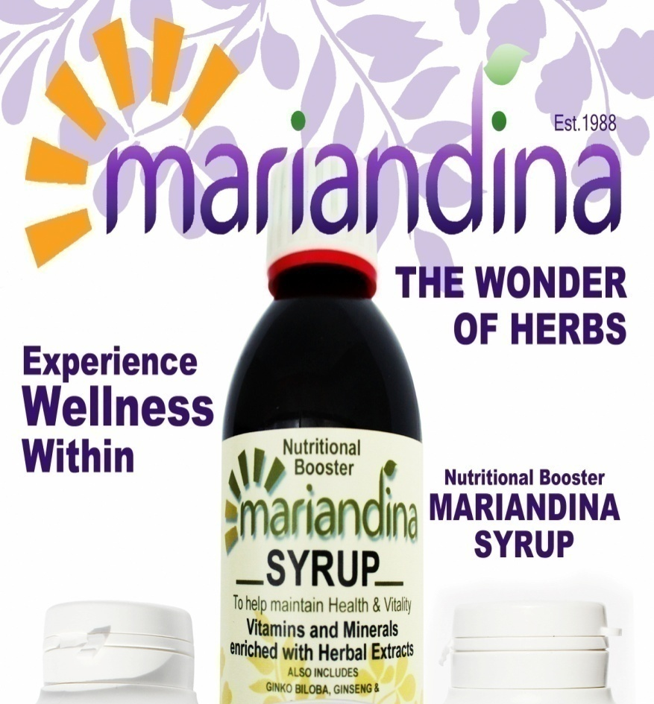
MARIANDINA SYRUP is a natural food supplement TONIC that
NOURISHES THE BODY and BOOSTS VITALITY
MARIANDINA SYRUP
BIRCH LEAF
ZINC
CALCIUM
VITAMIN C
FOLIC ACID
VITAMIN B12
VITAMIN B3
GINKGO BILOBA
VITAMIN B6
PANAX GINSENG
VITAMIN B3
HAWTHORN
VITAMIN B2
IODINE
VITAMIN B1
IRON
SODIUM
SARSAPARILLA
POTASSIUM
MANGANESE
LYSINE

Slide 11
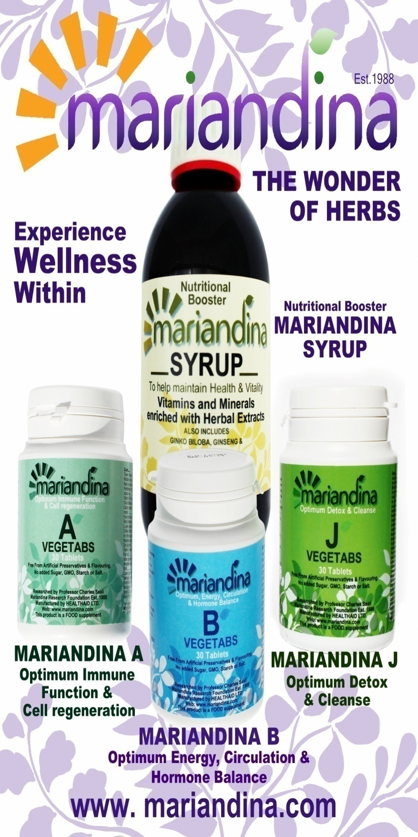
MARIANDINA SYRUP is a natural food supplement TONIC that
NOURISHES THE BODY and BOOSTS VITALITY
MARIANDINA SYRUP
BIRCH LEAF assists Urinary tracts infections, edema, cystitis,
CALCIUM Rickets, Osteoporosis, required for bones and teeth.
FOLIC ACID for DNA synthesis and normal cell replication.
GINKGO BILOBAimproves memory,prevents clots,Brain function
SIBERIAN GINSENG detoxifies harmful toxins, improves stamina
HAWTHORN for Heart function, Angina, lowers blood pressure
IODINE is used make thyroid hormones and normal metabolism
IRON Helps with fatigue, helps muscles store energy, Depression
LYSINEhelps maintain blood vessels, growth, calcium absorption
MANGANESE for healthy skin, bone and cartilage formation
POTASSIUM regulates water balance, acidity, blood pressure
SARSAPARILLA Eczema, Psoriasis, arthritis, cancer, skin diseases
SODIUM maintains blood and lymph health, weight loss
VITAMIN B1 required to form ATP, Nerve Cells, mouth ulcers
VITAMIN B2 processes amino acids and fats, headaches, ulcers
VITAMIN B3 releases Energy from carbohydrates, regulates cholestrol. VITAMIN B5 aids energy production,lowers cholestrol
VITAMIN C required for collagen and prevents oxidative stress.

Slide 12
